Slide 1
Introduction to Molecular Dynamics Simulations

Slide 2
Outline
What is molecular Dynamics?
Numerical solutions to equations of motion
Ingredients of Molecular Dynamics Simulations
Constant energy molecular dynamics
Constant temperature molecular dynamics
Other Considerations
Summary

Slide 3
What is Molecular Dynamics?
Molecular dynamics provides a means for dynamical quantities [i.e. time-dependent quantities] and thermals quantities of a system to be readily computed.
Examples of such properties are:
the rate of diffusion (how fast or slow atoms move when subjected to thermal effects)
thermal conductivity of a material (how good or bad a material conducts heat)
Phase transformations in materials (how materials change, for example, their softness or hardness when subject to temperature and pressure)
$$\text{What} \text{is} \text{molecular} \text{dynamics}\text{?}$$
$$Molecular dynamics is the time evolution of a system of atoms described by$$
$$Newton^{′}s second law of motion under the influence of temperature (and pressure)$$

Slide 4
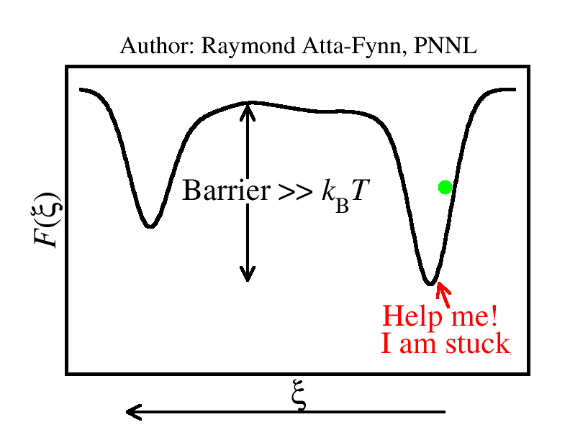
What is Molecular Dynamics?
Customized molecular dynamics simulations can be employed to access different energetic states of a system or material.
This applies to cases where the system can be trapped in one energy state for a long time [see cartoon; $ξ$ denotes a state of the system and $F(ξ)$ denotes energy of that state]

Slide 5
What is Molecular Dynamics?
Newton’s second law of motion: The net force $\vec{F}$ acting on object of mass $m$ is proportional to the object’s acceleration $\vec{a}$:
$$\vec{F}∝\vec{a}⇒\vec{F}=m\vec{a}$$
Since $\vec{a}$ is the rate of change of velocity $\vec{v}$ with time $t$ [that is, $\vec{a}={d\vec{v}}/{dt}$] and $\vec{v}$ is the rate of change of displacement $\vec{r}$ with $t$ [that is, $\vec{v}={d\vec{r}}/{dt}$], Newton’s second law can be restated at:
$$\vec{F}=m\frac{d\vec{v}}{dt} and \vec{v}=\frac{d\vec{r}}{dt}$$
$$\text{Newton}\text{′}\text{s} \text{second} \text{law} \text{employed} \text{in} \text{molecular} \text{dynamics}$$

Slide 6
What is Molecular Dynamics?
Consider a system of $N$ atoms of masses $\{m_{1}$, $m_{2}$,…., $m_{N}\}$ with atomic positions $\{{\vec{r}}_{1}$, ${\vec{r}}_{2}$,…., ${\vec{r}}_{N}\}$, velocities $\{{\vec{v}}_{1}$, ${\vec{v}}_{2}$,…., ${\vec{v}}_{N}\}$ under the action forces $\{{\vec{F}}_{1}$, ${\vec{F}}_{2}$,…., ${\vec{F}}_{N}\}$ at a given instant in time $t$.
Per Newton’s second law, the time evolution of the system is governed by the pair of coupled equations:
$$\begin{matrix}\frac{d{\vec{v}}_{i}(t)}{dt}=\frac{{\vec{F}}_{i}}{m_{i}} \\ \frac{d{\vec{r}}_{i}(t)}{dt}={\vec{v}}_{i}\end{matrix} [1]$$
where $i=1, 2,…,N$ labels the atoms
Let us examine a few standard numerical algorithms to solving the system of equations in $\left[1\right]$ above.

Slide 7
What is Molecular Dynamics?
Before we delve into widely employed numerical algorithms in molecular dynamics simulation, let us examine a few heuristics.
First, we note following about numerical approximation to first derivatives:
$${d{\vec{v}}_{i}(t)}/{dt}≈{\left[{\vec{v}}_{i}\left(t+∆t\right)−{\vec{v}}_{i}\left(t\right)\right]}/{∆t}$$
$${d{\vec{r}}_{i}(t)}/{dt}≈{\left[{\vec{r}}_{i}\left(t+∆t\right)−{\vec{r}}_{i}\left(t\right)\right]}/{∆t}$$
where it is implicitly assumed that $∆t$ is small enough.
Per the above approximations, a simple solution to the pair of Newton’s equations are:
$$\frac{d{\vec{v}}_{i}}{dt}=\frac{{\vec{F}}_{i}}{m_{i}} ⇒{\vec{v}}_{i}\left(t+∆t\right)≈{\vec{v}}_{i}\left(t\right)+{\vec{a}}_{i}\left(t\right)∆t \left[where {\vec{a}}_{i}\left(t\right)=\frac{{\vec{F}}_{i}\left(t\right)}{m_{i}}\right]$$
$$\frac{d{\vec{r}}_{i}}{dt}={\vec{v}}_{i} ⇒{\vec{r}}_{i}\left(t+∆t\right)≈{\vec{r}}_{i}\left(t\right)+{\vec{v}}_{i}\left(t\right)∆t$$
where $i=1, 2,…,N$ and $∆t$ is known as the time step.
Let us examine a few standard numerical approaches

Slide 8
Numerical solutions to equations of motion
Verlet method: The equations of motion are
$${\vec{r}}_{i}\left(t+∆t\right)=2{\vec{r}}_{i}\left(t\right)−{\vec{r}}_{i}\left(t−∆t\right)+{{\vec{a}}_{i}\left(t\right)\left(∆t\right)}^{2} where {\vec{a}}_{i}\left(t\right)=\frac{{\vec{F}}_{i}\left(t\right)}{m_{i}}$$
$${\vec{v}}_{i}\left(t\right)=\frac{{\vec{r}}_{i}\left(t+∆t\right)−{\vec{r}}_{i}\left(t−∆t\right)}{2∆t}$$
Advantages of the Verlet method: (i) Straightforward to implement; (ii) the propagation of the atomic positions does not explicitly require the atomic velocities [thus one can ignore the velocities unless they are really needed]
Disadvantages of the Verlet method: (i) It is non-self starting; (ii) the velocities accumulate significant round-off errors (especially for dynamics spanning long time scales)

Slide 9
Numerical solutions to equations of motion
Leapfrog method: The equations of motion are
$${\vec{v}}_{i}\left(t+\frac{∆t}{2}\right)={\vec{v}}_{i}\left(t−\frac{∆t}{2}\right)+{\vec{a}}_{i}\left(t\right)∆t where {\vec{a}}_{i}\left(t\right)=\frac{{\vec{F}}_{i}\left(t\right)}{m_{i}}$$
$${\vec{r}}_{i}\left(t+∆t\right)={\vec{r}}_{i}\left(t\right)+{\vec{v}}_{i}\left(t+\frac{∆t}{2}\right)∆t$$
The velocity at time $t$ is given by
$${{\vec{v}}_{i}\left(t\right)=\left[{\vec{v}}_{i}\left(t−{∆t}/2\right)+{\vec{v}}_{i}\left(t+{∆t}/2\right)\right]}/2$$
Advantages of the Leapfrog method: (i) It is time reversible; (ii) it is symplectic (i.e. it conserves the energy of the system)
Disadvantage of the Leapfrog method: The velocities and positions are computed at different times, that is, they leap frog each other by half a time step [${∆t}/2$]

Slide 10
Numerical solutions to equations of motion
Velocity Verlet method: The equations of motion are
$${\vec{r}}_{i}\left(t+∆t\right)={\vec{r}}_{i}\left(t\right)+{\vec{v}}_{i}\left(t\right)∆t+\frac{1}{2}{{\vec{a}}_{i}\left(t\right)\left(∆t\right)}^{2} where {\vec{a}}_{i}\left(t\right)=\frac{{\vec{F}}_{i}\left(t\right)}{m_{i}}$$
$${\vec{v}}_{i}\left(t+∆t\right)={\vec{v}}_{i}\left(t\right)+\frac{1}{2}\left[{\vec{a}}_{i}\left(t\right)+{\vec{a}}_{i}\left(t+∆t\right)\right]∆t$$
Advantages of the velocity Verlet method: (i) It is time reversible; (ii) it is symplectic (i.e. it conserves the energy of the system)
This algorithm is very popular; it is very reliable and accurate. We will employ it in the Lab sessions.

Slide 11
Ingredients of Molecular Dynamics Simulations
The following are the key ingredients required to successfully execute a molecular dynamics:
(1) Atomistic model
(2) Interaction potential (or potential energy)
(3) Atomic forces
(4) Basic molecular dynamics observables: kinetic energy, total energy, temperature, and pressure.
(5) Thermodynamic ensembles: microcanonical and canonical ensembles
(6) The ergodic hypothesis
(7) Method for solving the equations of motion [already discussed in three previous slides]

Slide 12
Ingredients of Molecular Dynamics Simulations
Ingredient 1: Atomistic model:
Comprises a set of atoms, which representative of the system of interest, with well-defined positions (or coordinates) $\{{\vec{r}}_{1}$, ${\vec{r}}_{2}$,…., ${\vec{r}}_{N}\}$.
Normally, a random set of atomic positions are chosen subject to geometric constraints and other constraints such as the correct atomic density (i.e. the number of atoms per volume).
Atomistic model of a charged metal ion immersed in liquid
water.

Slide 13
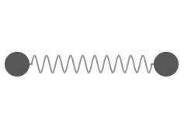
Ingredients of Molecular Dynamics Simulations
Ingredient 2: Potential energy (or interaction potential):
The potential energy of a system of $N$ atoms, denoted by $U$, tells us how the atoms interact with each or position themselves relative to each other.
The potential energy depends on the atomic positions: $U≡U({\vec{r}}_{1}\text{, }{\vec{r}}_{2}\text{,…., }{\vec{r}}_{N})$.
$U$ usually has a well-defined analytic/mathematical representation.
Example: the potential energy due to the bond between two atoms $i$ and $j$ located at positions ${\vec{r}}_{i}=(x_{i},y_{i},z_{i})$ and ${\vec{r}}_{j}=(x_{j},y_{j},z_{j})$ respectively, may be represented as
$$U({\vec{r}}_{i}\text{, }{\vec{r}}_{j})=\frac{1}{2}k{\left|{\vec{r}}_{i}−{\vec{r}}_{j}\right|}^{2}=\frac{1}{2}k\left[{(x_{j}−x_{i})}^{2}+{(y_{j}−y_{i})}^{2}+{(z_{j}−z_{i})}^{2}\right]$$
where $k$ is a constant.

Slide 14
Ingredients of Molecular Dynamics Simulations
Ingredient 3: Atomic forces:
The atomic forces (needed to solve the equations of motion) are obtained from the potential energy $U≡U({\vec{r}}_{1}\text{, }{\vec{r}}_{2}\text{,…., }{\vec{r}}_{N})$.
The force ${\vec{F}}_{i}$ acting on atom $i$ is given by the negative gradient of the potential energy $U$ with respect to the atom’s position ${\vec{r}}_{i}$:
$${\vec{F}}_{i}=−∇_{i}U\left({\vec{r}}_{1}\text{, }{\vec{r}}_{2}\text{,…., }{\vec{r}}_{N}\right)=−\frac{∂U}{∂{\vec{r}}_{i}}=\left(−\frac{∂U}{∂x_{i}},−\frac{∂U}{∂y_{i}},−\frac{∂U}{∂z_{i}}\right)$$
Example: if the potential energy of a 2-atom system is given by
$$U({\vec{r}}_{i}\text{, }{\vec{r}}_{j})=\frac{1}{2}k{\left|{\vec{r}}_{i}−{\vec{r}}_{j}\right|}^{2}=\frac{1}{2}k\left[{(x_{j}−x_{i})}^{2}+{(y_{j}−y_{i})}^{2}+{(z_{j}−z_{i})}^{2}\right]$$
where $k$ is a constant, then force ${\vec{F}}_{i}$ on atom $i$ is given by
$${\vec{F}}_{i}=\left(−\frac{∂U}{∂x_{i}},−\frac{∂U}{∂y_{i}},−\frac{∂U}{∂z_{i}}\right)=\left(k(x_{j}−x_{i}),k(y_{j}−y_{i}),k(z_{j}−z_{i})\right)$$

Slide 15
Ingredients of Molecular Dynamics Simulations
(4) Basic molecular dynamics observables:
(a) The total kinetic energy (i.e. the energy due to atomic motion) is
$$KE=\frac{1}{2}\sum_{i=1}^{N}{m_{i}{v_{i}}^{2}}$$
where $m_{i}$ and $v_{i}=\left|{\vec{v}}_{i}\right|$ are the mass and speed of atom $i$.
(b) The total energy $E$ of a system at any instant is the sum of the kinetic energy $KE$ and the potential energy $U$:
$$E=KE+U\left({\vec{r}}_{1}\text{, }{\vec{r}}_{2}\text{,…., }{\vec{r}}_{N}\right)=\frac{1}{2}\sum_{i=1}^{N}{m_{i}{v_{i}}^{2}}+U({\vec{r}}_{1}\text{, }{\vec{r}}_{2}\text{,…., }{\vec{r}}_{N})$$

Slide 16
Ingredients of Molecular Dynamics Simulations
Ingredient 4: Basic molecular dynamics observables:
(c) The temperature $T$ of the system at any instant is given by the equipartition theorem:
$$\frac{1}{2}N_{f}k_{B}T=KE ⇒ T=\frac{2KE}{N_{f}k_{B}}=\frac{\sum_{i=1}^{N}{m_{i}{v_{i}}^{2}}}{N_{f}k_{B}T}$$
where $N_{f}$ is the degrees of freedom (usually $N_{f}=3N−3$) and $k_{B}$ is the Boltzmann constant.
(d) The pressure $P$ of the system at any instant is given by virial equation
$$PV=Nk_{B}T−\frac{1}{3}\left\langle \sum_{i=1}^{N}{{\vec{F}}_{i}∙{\vec{r}}_{i}}\right\rangle ⇒P=\frac{Nk_{B}T}{V}−\frac{1}{3V}\left\langle \sum_{i=1}^{N}{{\vec{F}}_{i}∙{\vec{r}}_{i}}\right\rangle$$
where denotes average over all atoms in the system.

Slide 17
Ingredients of Molecular Dynamics Simulations
Ingredient 4: Basic molecular dynamics observables:
(c) The temperature $T$ of the system at any instant is given by:
$$\frac{1}{2}N_{f}k_{B}T=KE⇒T=\frac{2KE}{N_{f}k_{B}}=\frac{\sum_{i=1}^{N}{m_{i}{v_{i}}^{2}}}{N_{f}k_{B}T}$$
where $N_{f}$ is the degrees of freedom (usually $N_{f}=3N−3$) and $k_{B}$ is the Boltzmann constant.
(d) The pressure $P$ of the system at any instant is given by virial equation
$$PV=Nk_{B}T−\frac{1}{3}\left\langle \sum_{i=1}^{N}{{\vec{F}}_{i}∙{\vec{r}}_{i}}\right\rangle ⇒P=\frac{Nk_{B}T}{V}−\frac{1}{3V}\left\langle \sum_{i=1}^{N}{{\vec{F}}_{i}∙{\vec{r}}_{i}}\right\rangle$$
where denotes average over all atoms in the system.

Slide 18
Ingredients of Molecular Dynamics Simulations
Ingredient 5: Thermodynamic ensembles:
An ensemble, within the context of statistical thermodynamics, denotes an assembly of identical copies of a system in different states. We will consider only two of such ensembles.
(a) Microcanonical or (N,V,E) ensemble: In this ensemble, copies of the system each have the same number of particles $N$, the same volume $V$, and the same energy $E$. But each copy can be in a different state characterized by temperature $T$ and pressure $P$.
Example: an microcanonical ensemble comprising 6 copies; each copy has the same values of $N$, $V$, and $E$ [note that $N=4$]. However, each system can be in different $T$ and $P$ states.

Slide 19
Ingredients of Molecular Dynamics Simulations
Ingredient 5: Thermodynamic ensembles:
(b) Canonical or (N,V,T) ensemble: In this ensemble, copies of the system each have the same number of particles $N$, the same volume $V$, and the system is connected to a heat bath (or thermostat) to keep temperature $T$ constant. But each copy can be in a different state characterized by the energy $E$ and pressure $P$.
Example: a canonical ensemble comprising 3 copies; each copy has the same values of $N$, $V$, and $T$ [connected to heat bath]. However, each system can be in different $E$ and $P$ states.
heat bath
$T$
heat bath
$T$
heat bath
$T$

Slide 20
Ingredients of Molecular Dynamics Simulations
Ingredient 6: Ergodic Hypothesis:
Often in molecular dynamics simulations one is interested in some dynamical property $A$.
Per statistical thermodynamics, a representative value of the quantity $A$ is the average value $\left\langle A\right\rangle$, obtained by averaging $A$ is over a large ensemble (i.e. over several copies; see fig. below).
Practically, computing $\left\langle A\right\rangle$ is not feasible. Luckily, the ergodic hypothesis provides a solution.
$\left\langle A\right\rangle$ is the value of $A$ averaged over a large ensemble
$$………….$$
Ergodic Hypothesis: the time averaged value of $A$over a long time span in only a single copy of the system, denoted by $\overline{A}$ is equal to the emsemble average $\left\langle A\right\rangle$, that is,
$\left\langle A\right\rangle =\overline{A}$.

Slide 21
Other Considerations
Temperature Control in NVT simulation:
(i) Velocity scaling method
Scale velocities to match the target temperature [easy to implement]
Efficient, but does not correctly describe dynamics
(ii) Nose-Hoover thermostat
Fictitious degree of freedom is added but correctly describes NVT dynamics
Can cause temperature to fluctuate; not so easy to implement
(iii) Berendsen thermostat
Scales velocities to match temperature
Good compromise between the (i) and (ii); okay to use in simulations

Slide 22
Other Considerations
Initial velocities: Maxwell-Boltzmann velocity distribution
The Maxwell-Boltzmann (MB) probability of finding a particle with speed v_{x} at a given temperature T
Same for v_{y} and v_{z}
Generate random initial atomic velocities using the
Use the equipartition theorem to scale each initial velocity by a factor $γ$ so that the kinetic energy matches the temperature T :

Slide 23
Other Considerations
Choosing the time molecular dynamics step $∆t$
$∆t$ cannot be chosen to be too big other energy conservation will be destroyed
Typically, $∆t≤4 fs$ is employed [$fs$ denotes “femto-seconds” i.e. $1 fs={10}^{−15} f$].
It is fairly common to use $∆t=1 fs$ in practice
If the computational cost is very cheap or if highly accurate dynamical results are required, then choose $∆t$ as small as possible. E.g. $∆t=0.1 fs$ is considered small

Slide 24
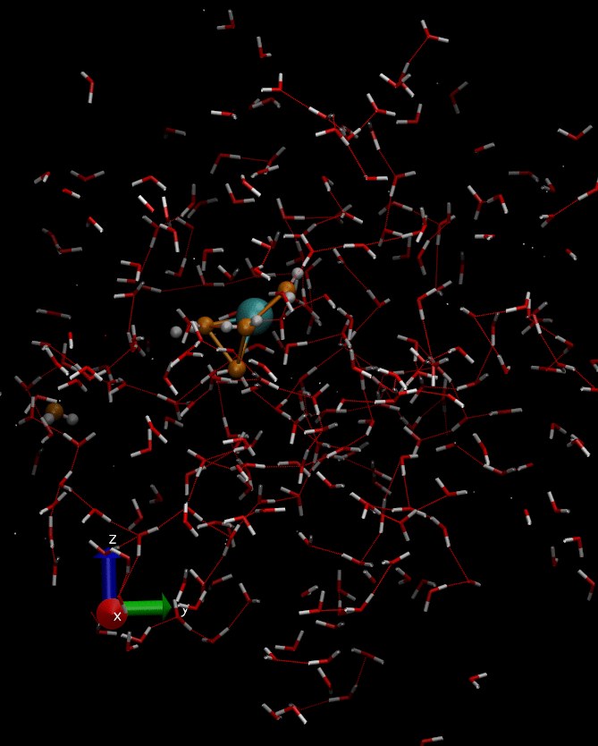
Molecular Dynamics in Action
Molecular dynamics simulations of a charged metal ion interacting with water molecules at room temperature (300 K).

Slide 25
Summary
Set initial conditions and
Get the forces
Use forces to olve the equations of motion
numerically over a short step
If NVT ensemble, then use thermostat to control temperature T
Is ?
Calculate results and finish

