Slide 1
2020 Summer Project at University of Texas, Arlington

Slide 2
Goal
To use free energy methods for disordered material discovery and simulate reactions in materials

Slide 3
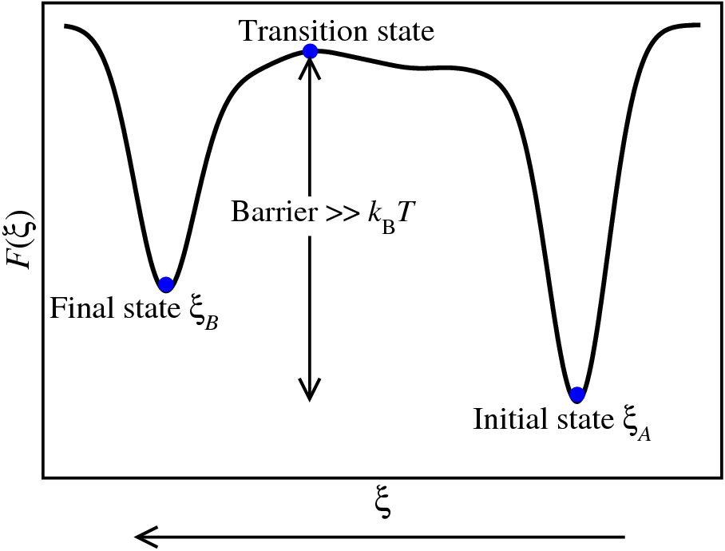
The state of most materials ambient conditions
Most systems get stuck in state ξ_{A} at room temperature (300 K)
The energy barrier must be exceeded for the change from state ξ_{A} to state the ξ_{B} to occur.

Slide 4
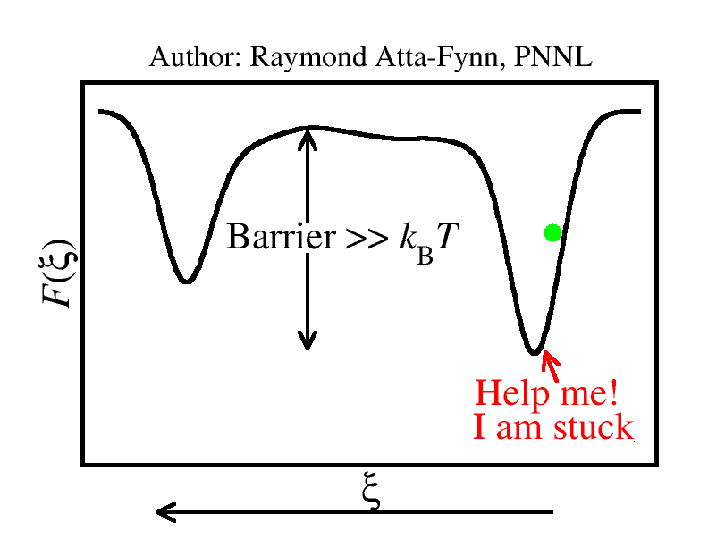
The free energy problem
Use an accelerated rare event sampling technique called metadynamics

Slide 5
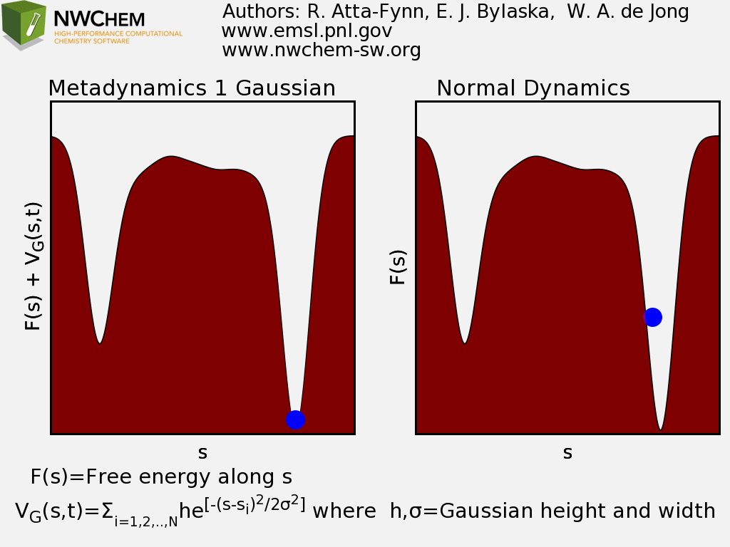
The metadynamics method
Identify a “good” collective variable s
The system (i.e. atoms, molecule, cluster, or solid) is the “blue ball” in the movie.
Periodically add external Gaussian bias potentials at the current value of s (think of water filling a well to push the ball)
This system is “forced” to visit new states

Slide 6
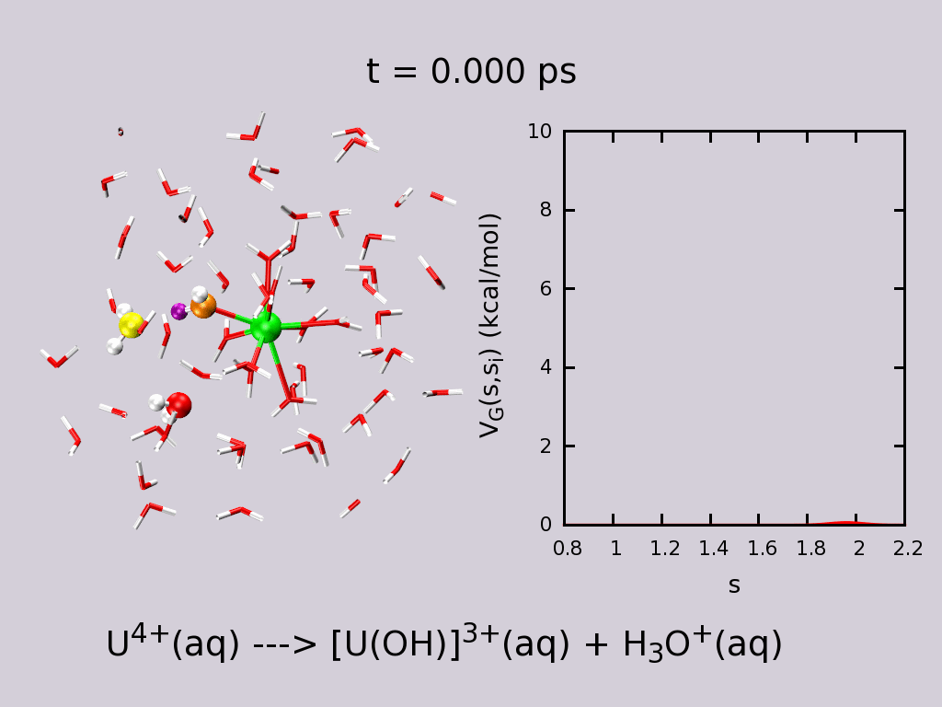
The metadynamics method
One can model all sorts of physical and chemical processes
Shown here is the metadynamics simulation of the deprotonation reaction of a solvated metal cation.
The collective variable in this case is the H-O-H bond coordination of O with respect to H.

Slide 7
Sketch of the 2020 summer project
Apply metadynamics to search for new configurations of disordered materials using well-chosen collective variables
Use the metadynamics approach develop a standard protocol to model high-quality atomistic models of disordered materials of varying compositions.

